Slide 1
Periodic Metasurface Inverse Design via Deep Learning
Shengnan

Slide 2
Update from last week
Still working on the meep
More data from S4
Working on visualize the result and optimize

Slide 3
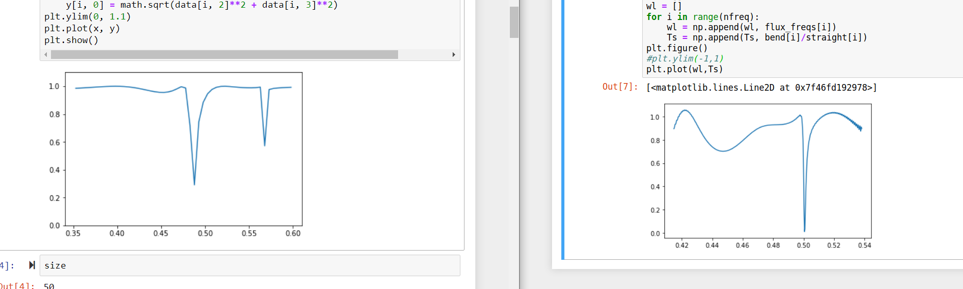
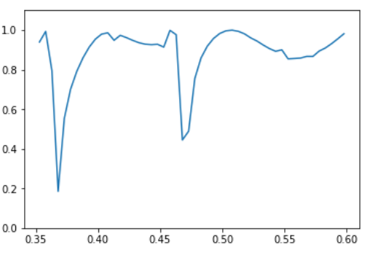
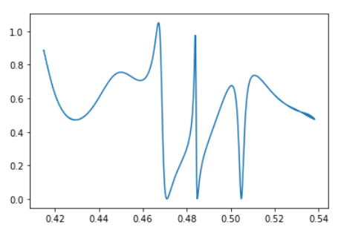
Meep
S4 result
Meep result
R_norm = 0.143
R_norm = 0.4093

Slide 4
Meep
Two potential problem:
Periodicity not properly applied
Experiment setup maybe improper
Distance of the light source to the unit cell
Distance of the Flux receive surface to the unit cell

Slide 5
More data
Data we have/Total # of data = 389/4899
One phenomena: More data trained one time, more false data we have.
Solution: separate the data and train again (still working on it)

Slide 6
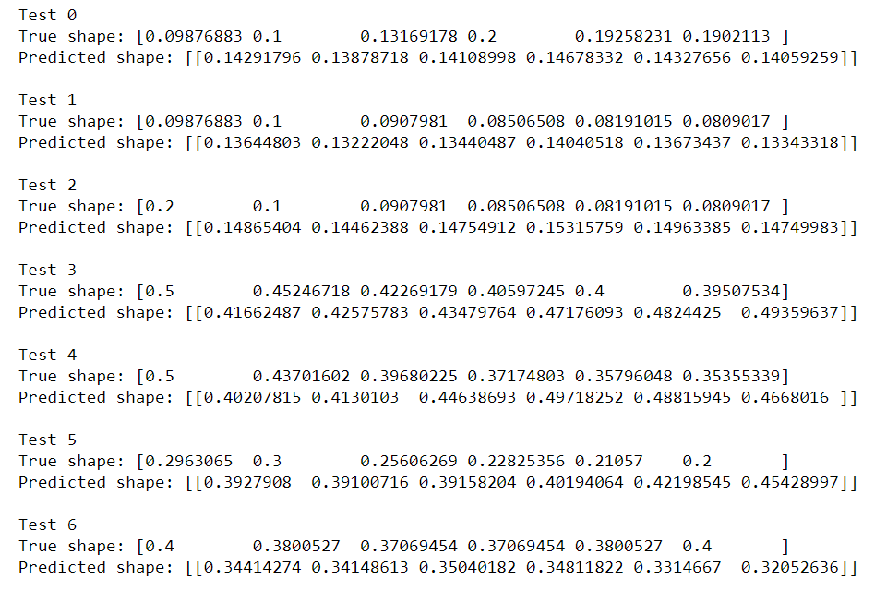
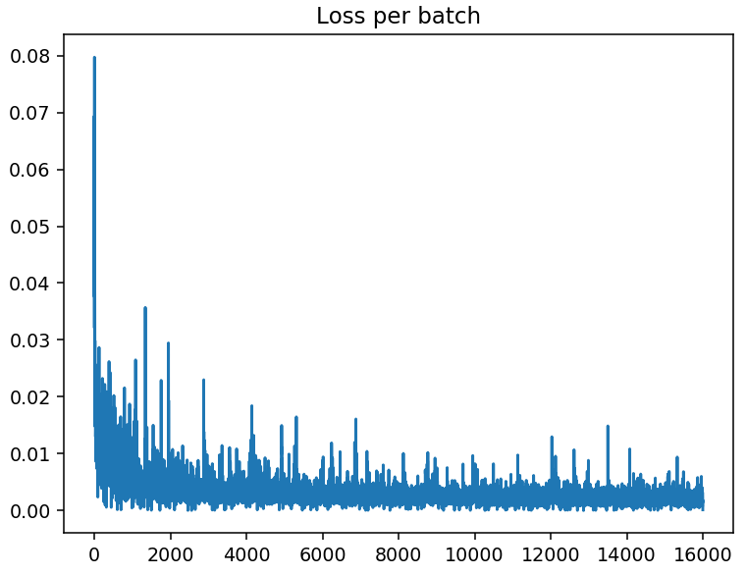
Neural Network Result
Cost is much higher compared to smaller dataset
Prediction is not accurate
Working on visualize the spectrum

Slide 7
Neural network
Different structure of neural network (different width per layer and different depth)
Try convolution neural network and Tandem neural network

Slide 8
This week
Investigate meep
periodicity and experiment setup
Improve and modify neural network
Goal: make neural network more converge
Methods: Tandem neural network and different structure of neural network
Generate more data
S4

